Slide 1


Aayush Chaurasia
March 12, 2025

Slide 2

Outline
Executive Summary
Introduction
Methodology
Results
Conclusion
Appendix

Slide 3
Executive Summary
For analysis on SpaceX past launches along with creating a predictive model and an interactive dashboard involves the following steps:
Data collection using SpaceX API and web scraping from Falcon9 wiki page.
Data wrangling and visualization using pandas and seaborn respectively. SQL queries also helped to understand the data in great detail. Folium helped to understand the geospatial data of SpaceX launch sites.
Creating classification models using Logistic Regression, SVM, Decision Tree and KNN.
Created a dashboard using ‘plotly dash’ to give the data insights a presentable view to the target audience.
Based on the analysis and creating predictive model we can say that the chance of first stage rockets to land depends on their payload mass, orbit, launch site which will help to attain optimal decision thereby controlling the cost of project.

Slide 4
Introduction
The commercial space age is here and companies are investing in space projects to make space travel convenient and affordable to the audience. There are several companies like Blue Orbital, Virgin Galactic and Rocket Lab working hard to make satellite providers and reusable rockets.
However, SpaceX founded by billionaire industrialist Elon Musk is one of the top companies among them who have a steady growth in their space missions with one of their popular projects called Falcon 9.
Our company SpaceY is trying to analyze the landing success probability of first stage rockets based on the data gathered from SpaceX sites in order to take a decision for future space projects for our company.
To solve this problem, we need to address the following questions:
How many landing sites are there in this project?
Which landing sites have the most successful landings?
How factors like boosters, payload mass affects the landing success?

Slide 5

Section 1

Slide 6
Methodology
Executive Summary
Data collection methodology:
For collection of data we used SpaceX API endpoint (api.spacexdata.com/v4/) with data about cores, rockets and their past launches via web scraping tools.
Perform data wrangling
The collected data consists Flight Number, Date, Booster Version, Payload Mass, Orbit, Launch Site and Outcome. We will convert Outcome as target binary class data (0 or 1). The remaining data will be transformed as numerical data with standardization.
Perform exploratory data analysis (EDA) using visualization and SQL
Perform interactive visual analytics using Folium and Plotly Dash
Perform predictive analysis using classification models
We used various classification models including Logistic Regression, Support Vector Classifier, Decision Tree Classifier and KNN with best hyperparameters using Grid Search CV to pick the best model among them.

Slide 7
Data Collection
For data collection, we used SpaceX REST API endpoint along with web scraping libraries like BeautifulSoup to collect data on rockets, past launches and other details to get insights on Falcon9 space missions.
The API had several endpoints:
/cores: Details about the rocket cores.
/rockets: Details about their rockets, with booster types and versions.
/past: This contained data about their past launches with their corresponding dates.
The data was scraped as HTML format which was later converted as pandas dataframe format which is a 2-dimensional tabular data.

Slide 8
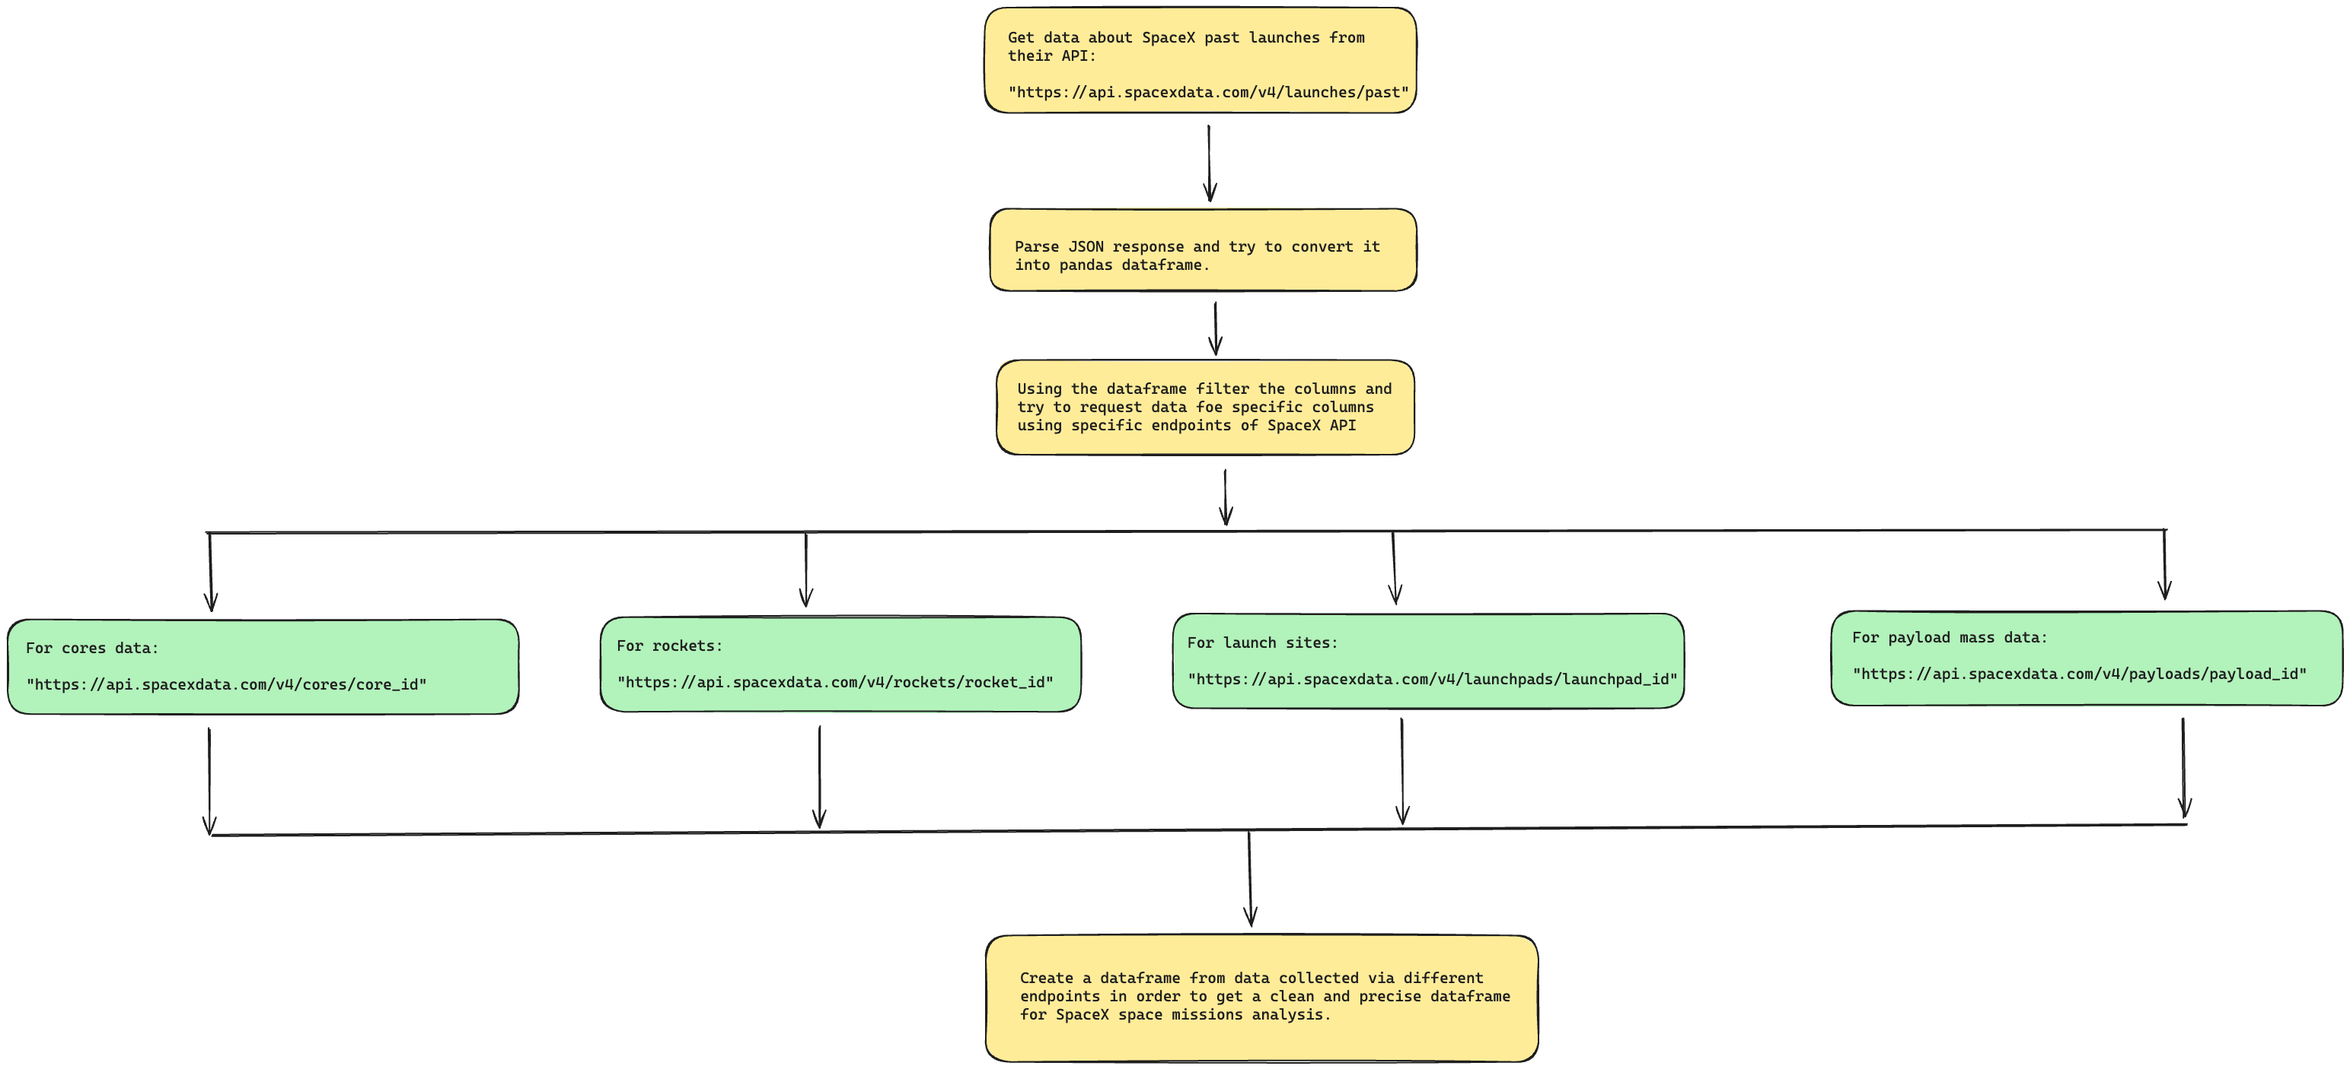
Data Collection – SpaceX API
First we got data on past launches from /past endpoint.
Then using the parsed data we’ll request data from different endpoints by passing the unique id that was there in the parsed data.
We will parse data from:
/cores
/payloads
/rockets
/launchpads
For reference, check out the jupyter notebook on this GitHub repo.

Slide 9
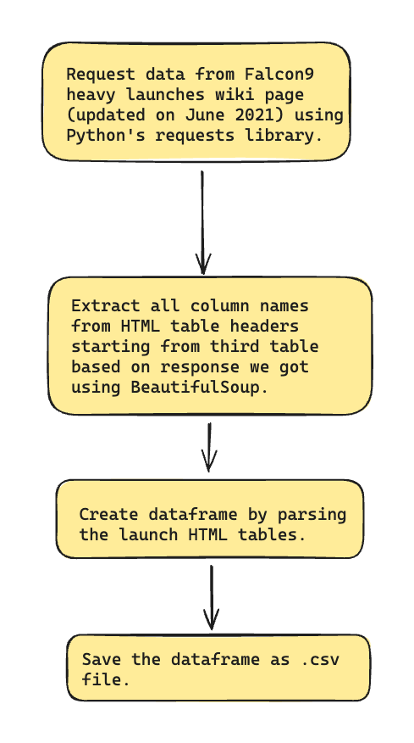
Data Collection - Scraping
Using requests library get the data from wiki page and scrape the text response using beautifulsoup.
Then extract the column names from table headers starting from the third table.
For complete process of data collection via scraping, checkout the GitHub repo.

Slide 10
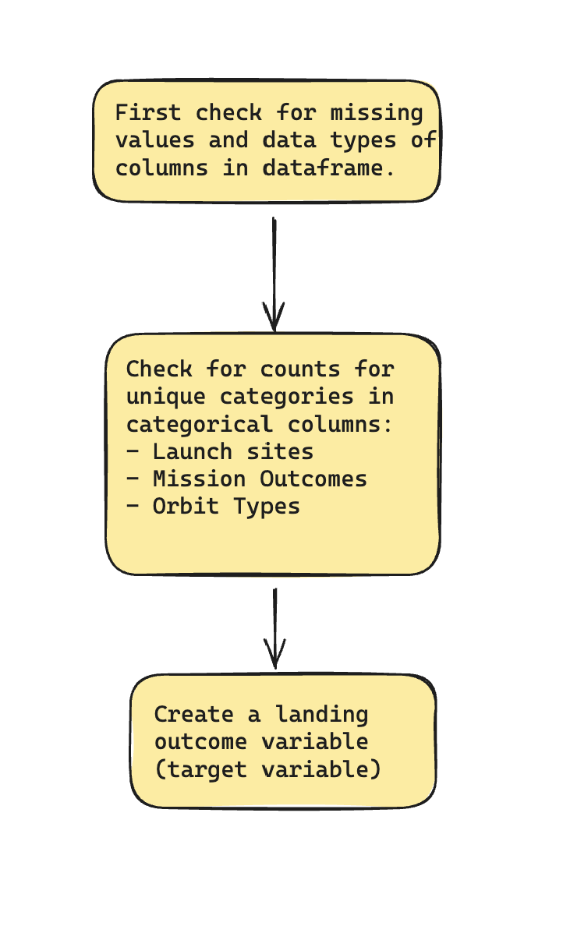
Data Wrangling
First, we will check the missing values and data types of columns in the dataframe.
Check for counts for the following:
Number of launches on each site.
Number and occurrence of each orbit.
Number of occurrence of mission outcomes of the orbits.
Create a landing outcome label from Outcome column which will be our target variable.
For further details, go to my repo.

Slide 11
EDA with Data Visualization
For visualizing relationship between two variables, we used scatter plots for:
Payload Mass vs Flight Number
Launch Site vs Flight Number
Launch Site vs Payload Mass
Orbit vs Flight Number
Orbit vs Payload Mass
For relationship between success rate and orbit, bar graph was used.
To visualize launch success yearly trend we used line plot.
For reference, checkout the GitHub repo.

Slide 12
EDA with SQL
Displayed the names of unique launch sites in the space mission.
Displayed the first five launch sites starting with ‘CCA’.
Displayed total and average payload mass carried by boosters launched by NASA (CRS).
Listed the date when first successful landing was achieved.
Listed the names of boosters which have success in drone ship and have payload mass between 4000 and 6000.
Listed total number of successful and failed mission outcomes.
Displayed the names of booster versions which have carried maximum payload mass.
Displayed monthly failed missions in the year 2015.
Displayed the count of failure (drone ship) and success (ground pad) between dates 2010-06-04 and 2017-03-20 in descending order.
Reference - GitHub Repo

Slide 13
Build an Interactive Map with Folium
First we created a Folium Map object followed by markers to display the launch sites where the space missions took place in the past on the map.
Then, to display the successful and failed missions, we created a marker cluster object and based on their corresponding color (success = green, failure = red) we marked their locations on the map using marker object.
Then we calculated the distance of launch site from nearest railway, coastline, city and highway to know the proximities of the site.
Reference - Repo

Slide 14
Build a Dashboard with Plotly Dash
To build a dashboard we used the following components and graphs:
Dropdown
Pie chart
Range Slider
Scatter plot
The dropdown has a list of launch sites from which we can choose and render the pie charts and scatter plots based on that.
The Range slider controls the payload mass range from 0 (min) to 10000 (max).
The pie chart displayed the success rates of various sites based on option selected from dropdown.
The scatter plot displayed relation between outcome (class) and payload mass based on the launch site and payload range selected.
GitHub Repo

Slide 15
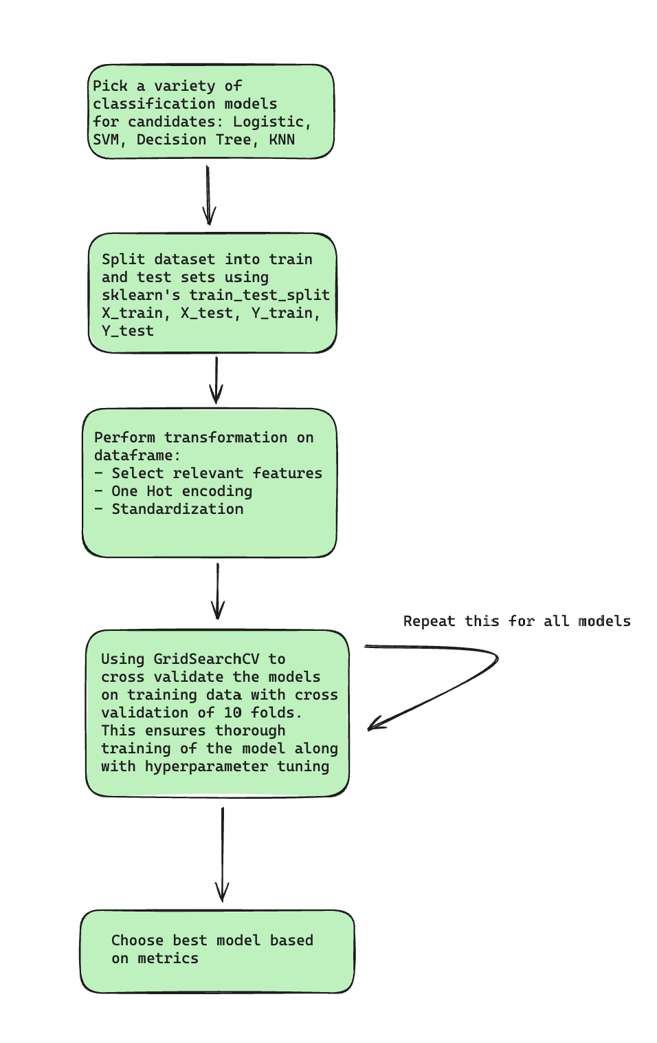
Predictive Analysis (Classification)
First we considered a set of algorithms for classification which includes: Logistic Regression, SVM, Decision Tree and KNN classifier.
This was followed by splitting the dataset into training and testing sets.
Then we passed the transformed train data after selecting features, one hot encoding categorical and standardizing it to the model and evaluated their metrics one by one.
Using GridSearchCV we performed hyperparameter tuning of the models in order to pick best among them.
The model which had the best metrics was considered as the best classifier model.
Reference – GitHub Repo

Slide 16
Results
After doing EDA, it was evident that:
With time progression, success rates increased at a steady rate since 2013.
Only particular orbits like GEO, PO and ISS showed an increase in first stage phase success when payload was increased.
Landing site like KSC LC-39A had highest success rate among all landing sites which could be one of the most preferred locations for first stage launch missions.
The predictions calculated by the model shows that:
Model is able to obtain high precision (high amount of true positives) and god recall (quite a few false positives), that shows that the model is able to grasp the patterns in the data.
Since there were multiple candidates for best model. Keeping simplicity in mind, it was best to go with Logistic Regression as the data was already transformed with no missing and no outlier values. Decision Tree might be good, however it was overfitting on the train data making it a less preferred choice. One may requiring using pruning techniques to make it a strong candidate for the final model.

Slide 17

Section 2

Slide 18
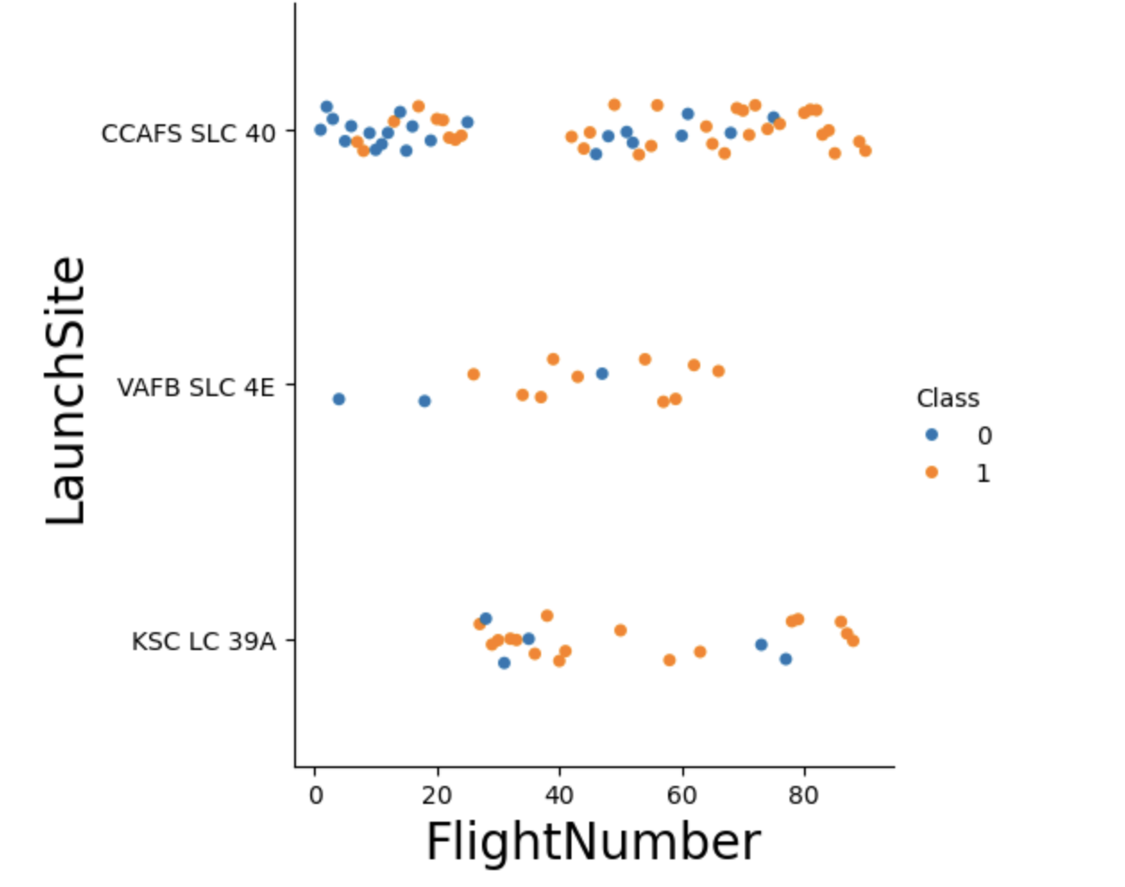
Flight Number vs. Launch Site
The scatter plot on the right demonstrates the relation between LaunchSite and FlightNumber.
Here the scatterplot is colored on the basis of mission outcome (0 for failure and 1 for success).
As we can see the patterns in the plot shows that the chances of successful landing gets increased as the flight number increases.
This is because due to failed missions in the past, they are trying to mitigate the drawbacks that have happened in the past space missions in their first stages.

Slide 19
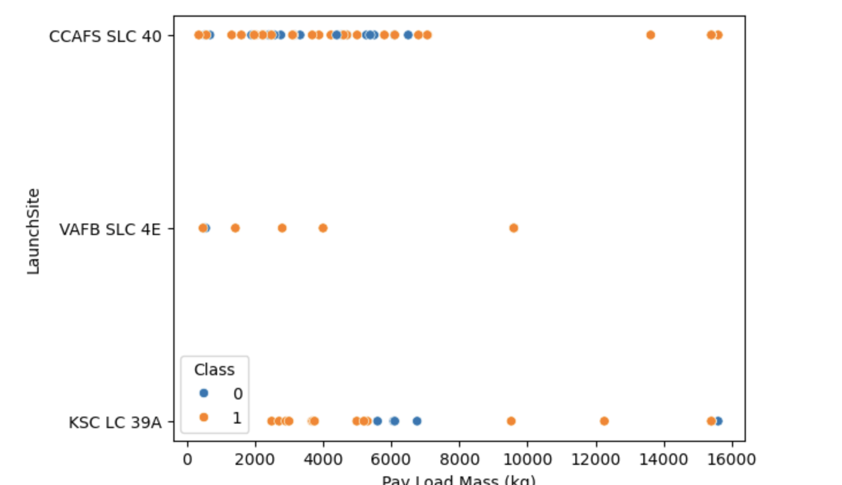
Payload vs. Launch Site
The scatter plot on the right demonstrates the relation between LaunchSite and Payload Mass (kg).
In this, we can see that for launch site VAFB SLC 4E, there were no heavy rockets with payload mass greater than 10000.
For other launch sites the payload mass has gone up to 16000.

Slide 20
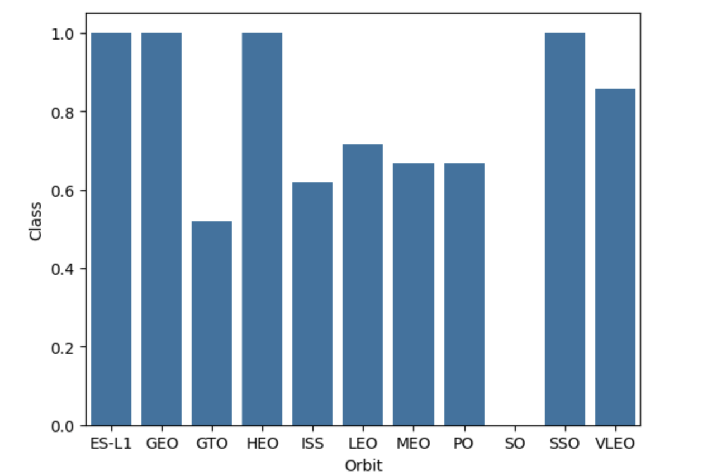
Success Rate vs. Orbit Type
The plot on the right demonstrates the relation between Landing Outcome and Orbit.
As we can see, the following orbits have the highest success rates:
ES-L1
GEO
HEO
SSO
GTO has the lowest success rate.

Slide 21
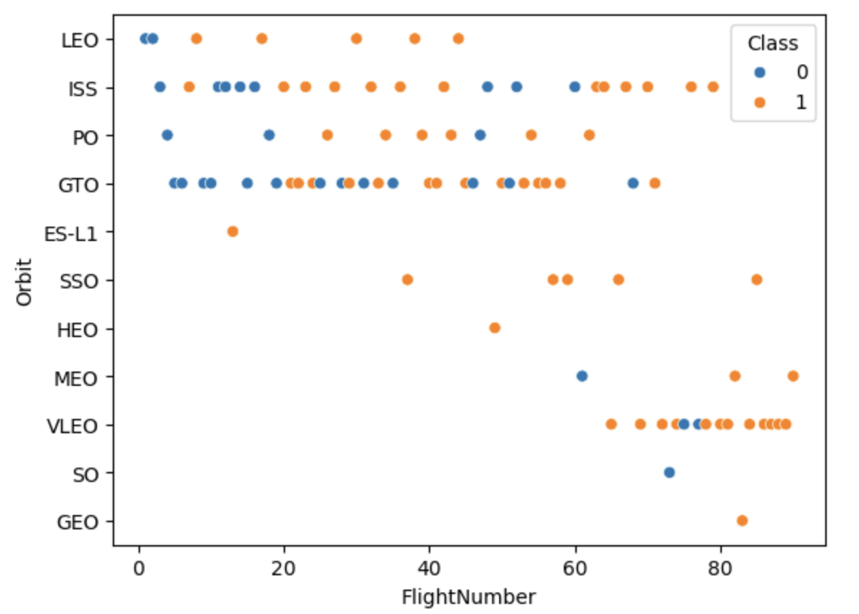
Flight Number vs. Orbit Type
The plot on the right shows relation between Orbit and FlightNumber.
Here, in case of LEO orbit, success rate seems to be related to the number of flights.
On the other hand, in case of GTO there is no relation.

Slide 22
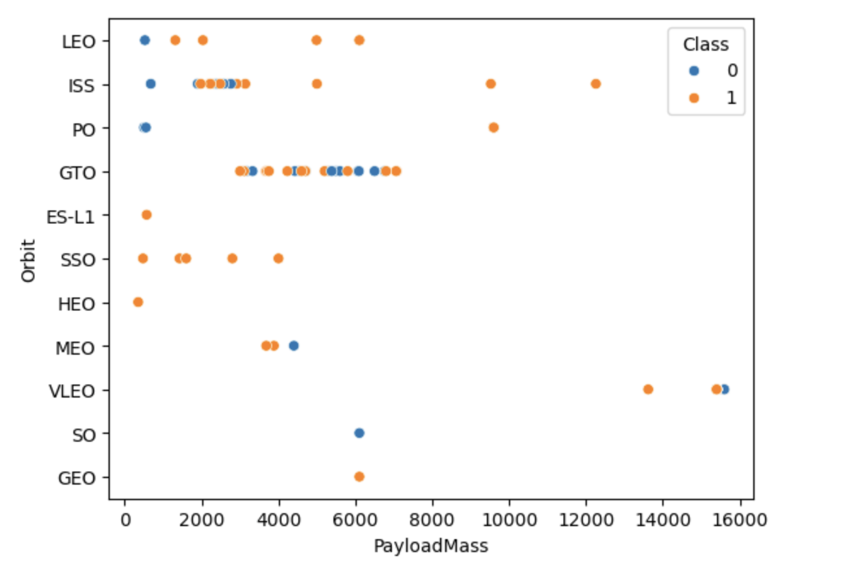
Payload vs. Orbit Type
The plot shows the relation between Orbit and Payload Mass.
As we can see, heavier payload mass rockets have more chances of being successful in case of LEO, PO and ISS orbits.
Orbits SO and GEO have the least number of rockets with only one rocket with payload mass of 6000.

Slide 23
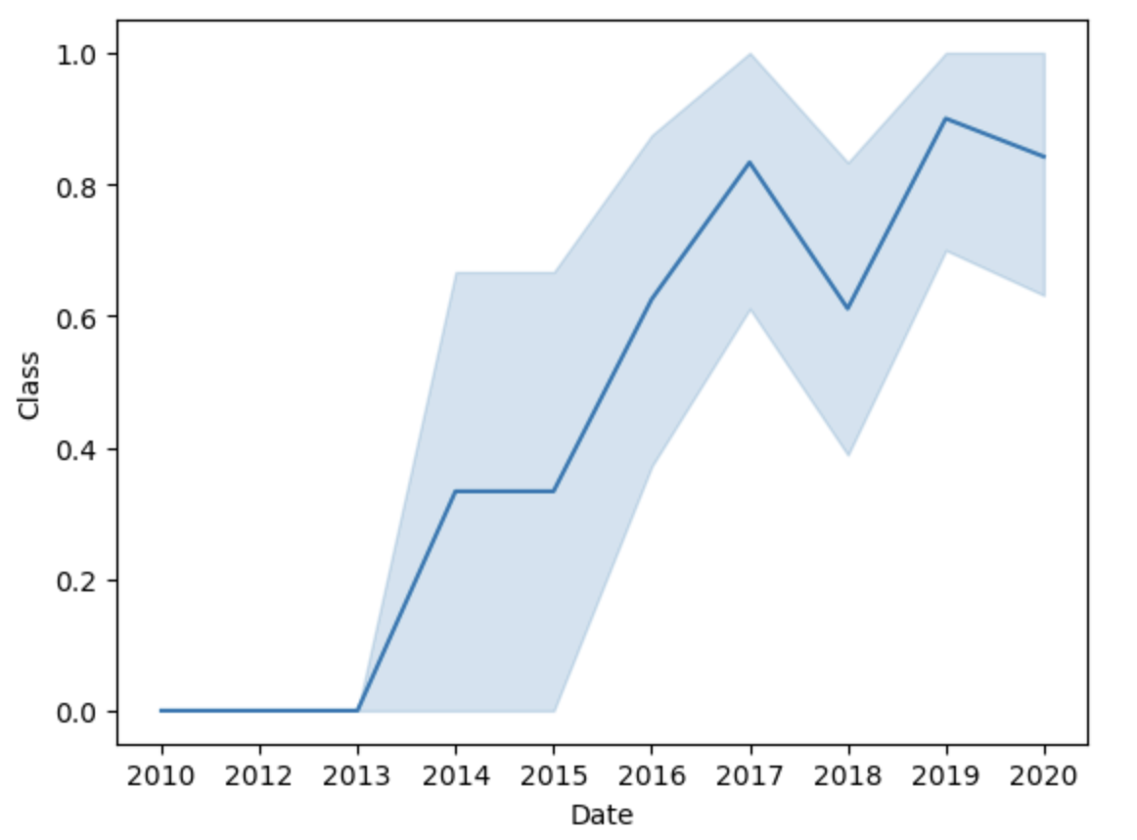
Launch Success Yearly Trend
Shows relationship between Landing Outcome and Date of launch.
This shows that the success rate kept increasing since 2013 till 2020.
There is a sudden rise in success rate after 2013.

Slide 24
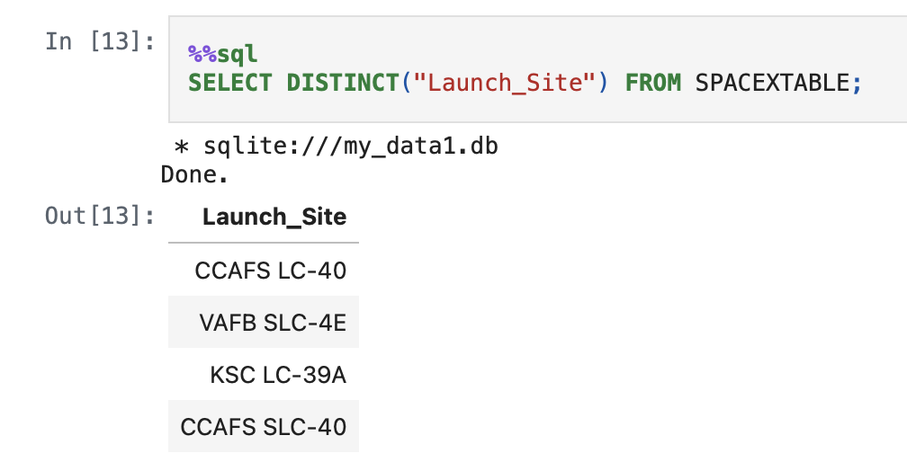
All Launch Site Names
This query displays the unique names of launch sites from the SPACEXTABLE.
The result shows total 4 unique launch sites.

Slide 25
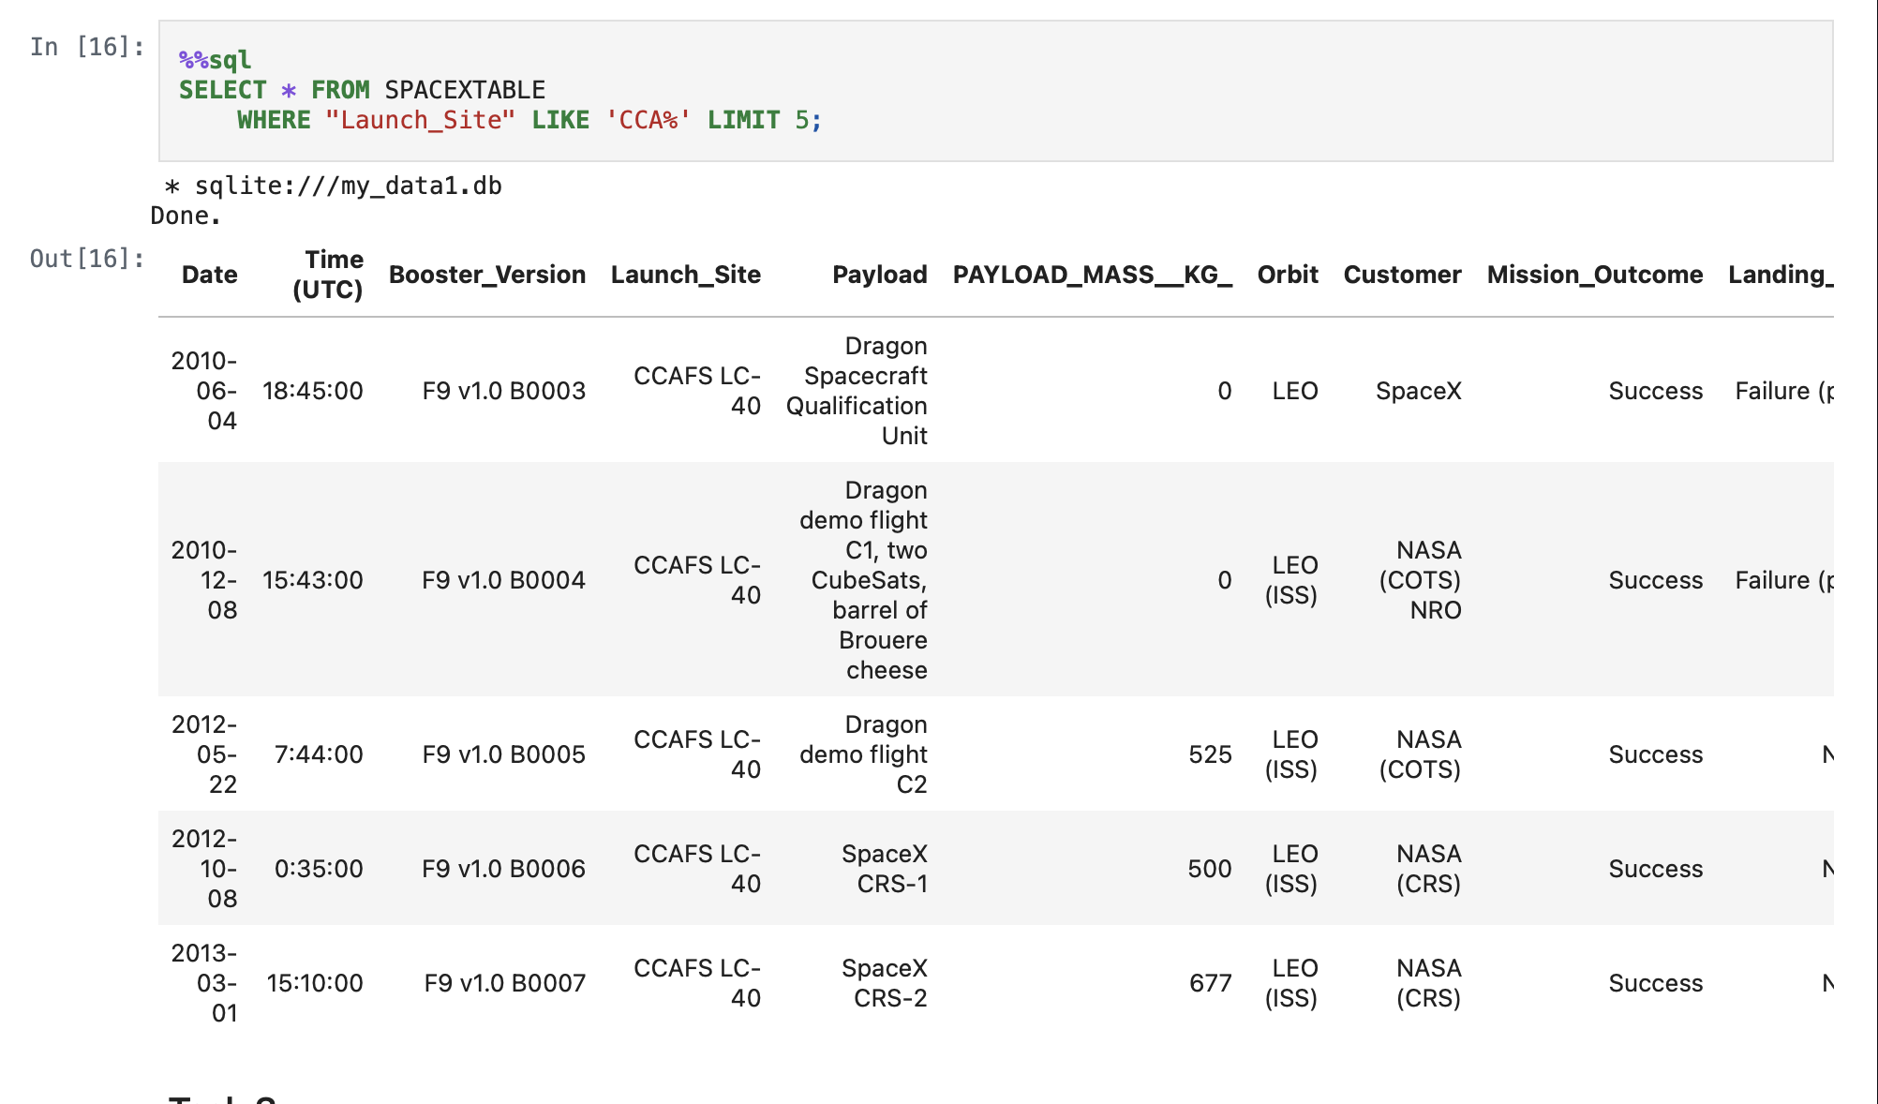
Launch Site Names Begin with 'CCA'
This query displays the top 5 rows from the SPACEXTABLE where launch site starts with ‘CCA’.
The result shows two launches in 2010, two in 2012 and one in 2013.

Slide 26
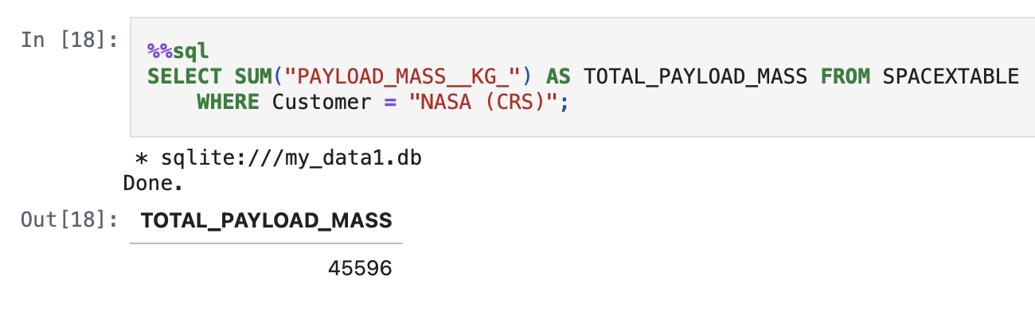
Total Payload Mass
This query sums all the payload masses from the SPACEXTABLE, where Customer is ‘NASA (CRS)’.
The total payload mass is 45596 kg.

Slide 27
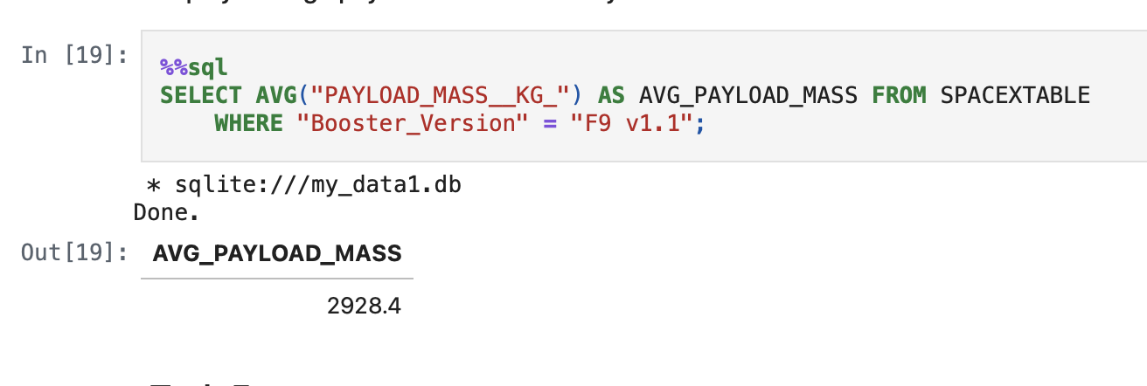
Average Payload Mass by F9 v1.1
Here, we try to calculate mean of payload mass with an alias as AVG_PAYLOAD_MASS from SPACEXTABLE for booster version F9 v1.1.
The average comes around 2928.4 kg.

Slide 28
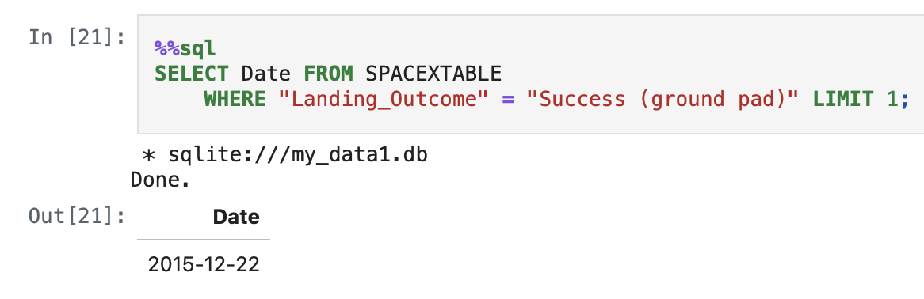
First Successful Ground Landing Date
Displays the top 1 row where landing outcome is success (ground pad).
The first successful ground landing date was on 22nd Dec., 2015.

Slide 29
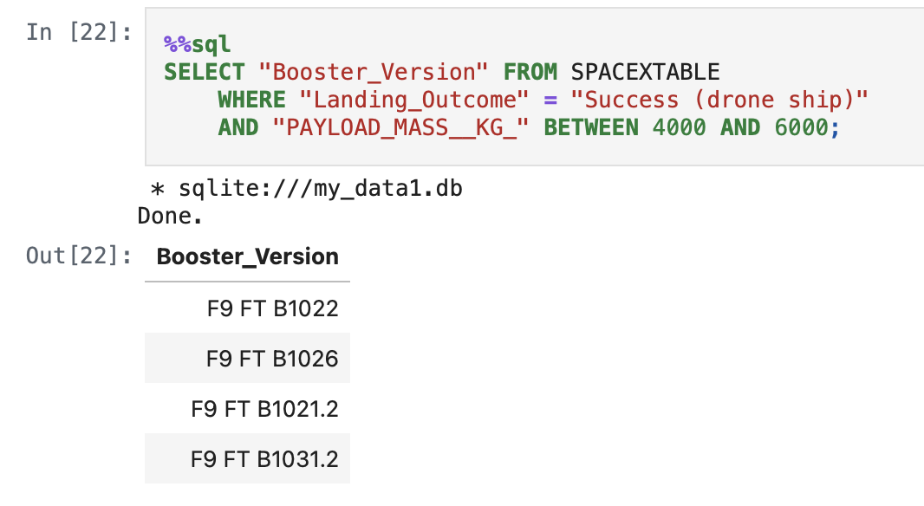
Successful Drone Ship Landing with Payload between 4000 and 6000
The booster versions: F9 FT B1022, F9 FT B1026, F9 FT B1021.2 and F9 FT B1031.2 have successful drone ship landing with payload between 4000 and 6000.

Slide 30
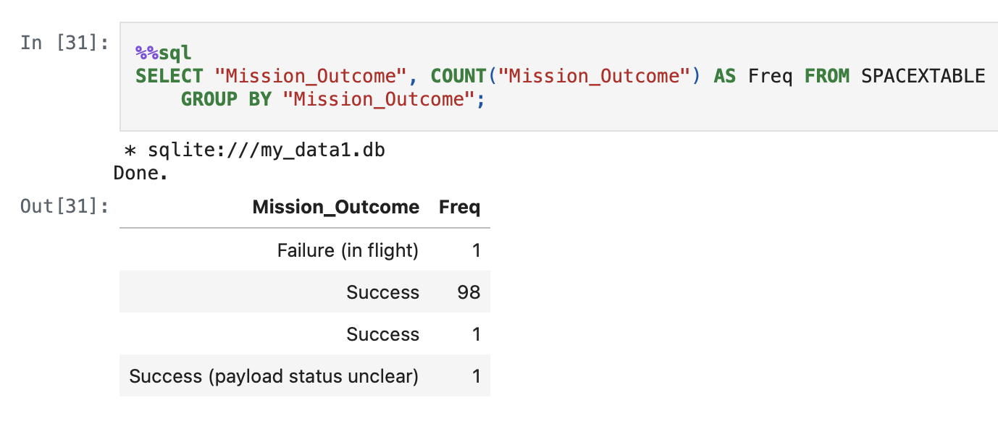
Total Number of Successful and Failure Mission Outcomes
First, we will group the table on the basis of mission outcome followed by displaying mission outcome and their corresponding counts.
We can say that no. successes = 100 and failure = 1.

Slide 31
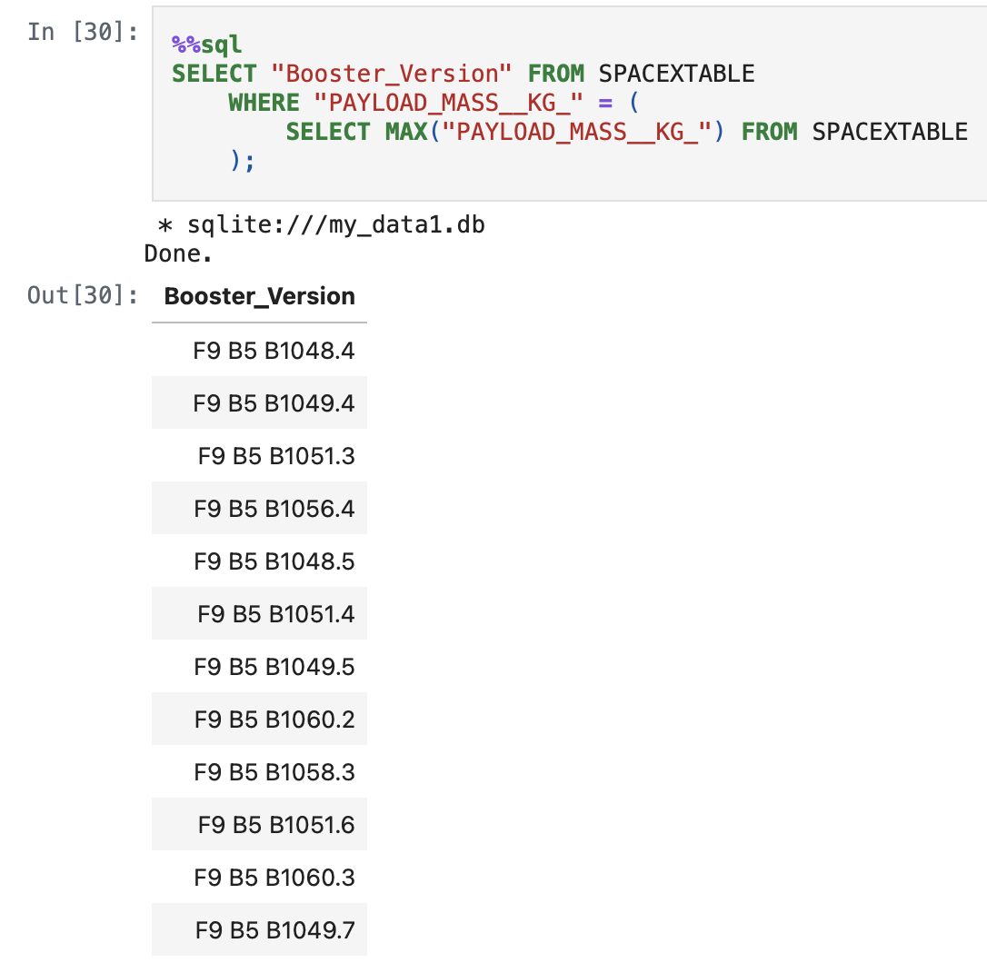
Boosters Carried Maximum Payload
There are several boosters which have carried maximum payload mass in their space missions.

Slide 32
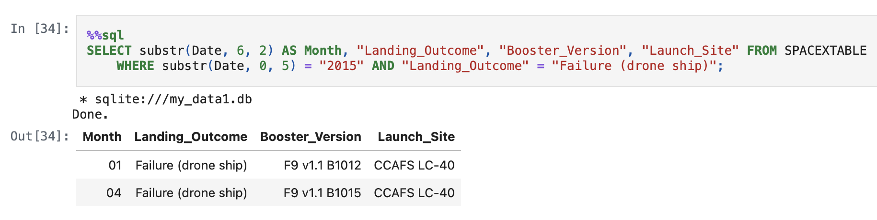
2015 Launch Records
Here it is evident that in the year 2015, there were two failed drone ship missions happened in the months of January and April.
These two failures happened at the same launch site.

Slide 33
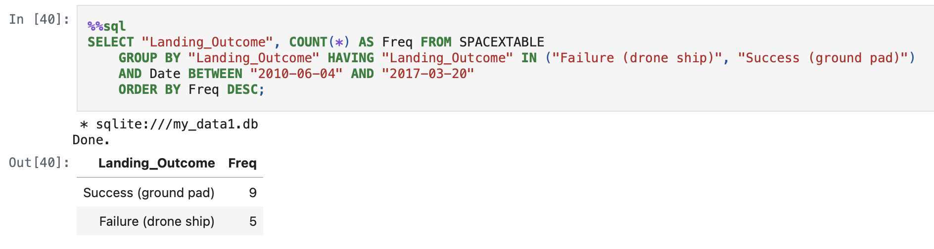
Rank Landing Outcomes Between 2010-06-04 and 2017-03-20
This shows that the success landing on ground pad has the highest frequency followed by failure of drone ships.

Slide 34

Section 3

Slide 35
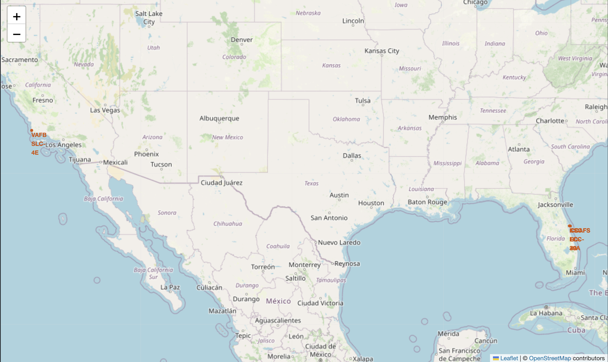
Launch Sites Location on Global Map
The screenshot shows the launch sites as marker objects where the mission took place.
First a folium map was created, followed by adding markers as a child object on the Folium Map object.
Marker color is red with a circle of radius 1000 units.

Slide 36
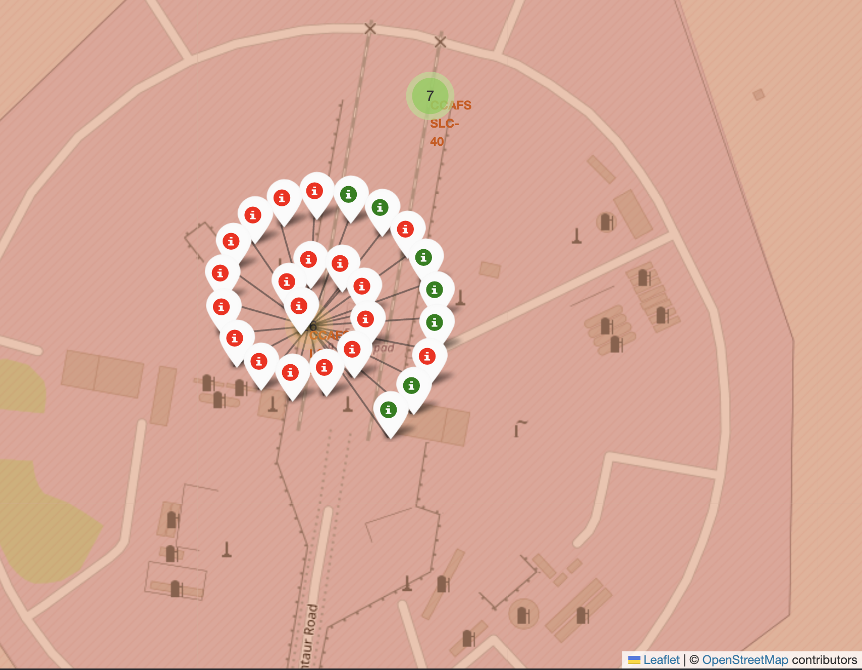
Success Rate Launch Outcome Markers
This screenshot demonstrates the successful and failed launch outcomes of past missions shown as markers with color code (green for success, red for failure) at a specific launch site.
Based on the number of success and failures we can determine which sites are prone to failure for landing during first stage phase.

Slide 37
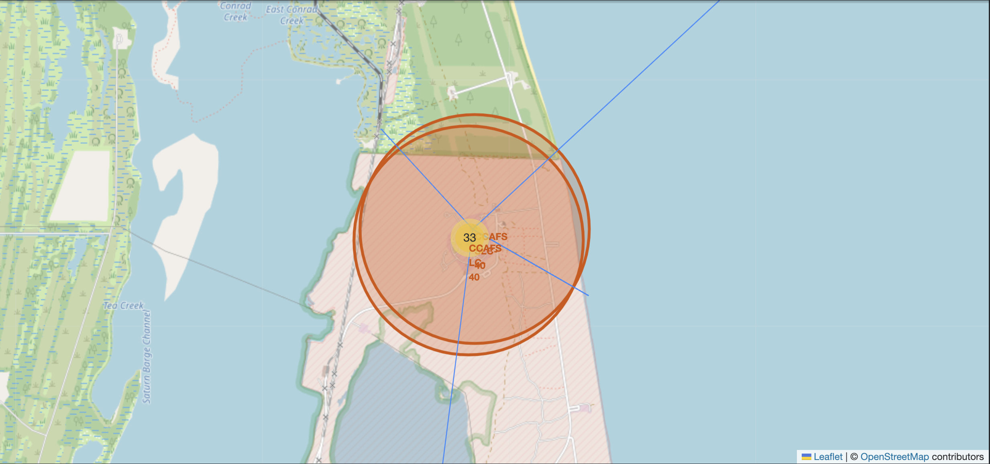
Proximity of nearest civil areas from launch site
This screenshot shows the proximity of nearest highway, railway, city and coastline from the launch site.
It is evident from the diagram that the launch site is in proximity with railway, highway and coastline areas with city being the farthest.

Slide 38

Section 4

Slide 39
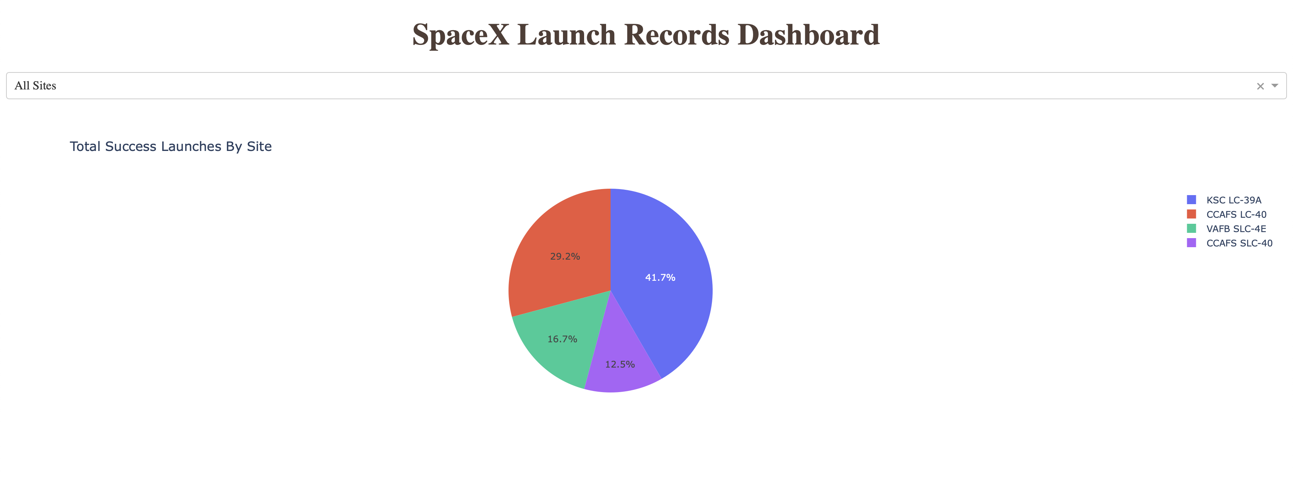
Total Success Launches By Site
The pie chart shows the proportion of success rates for all sites.
The launch site KSC LC-39A has the highest success rate and CCAFS SLC-40 has the lowest.

Slide 40
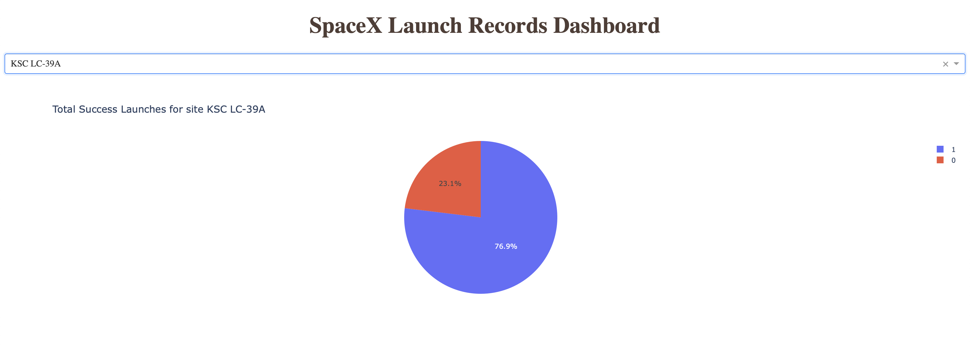
Success Rate of Launch Site with Highest Success Ratio
The launch site KSC LC-39A has the highest success ratio with success rate around 77%.
Failure Rate is 23%.

Slide 41
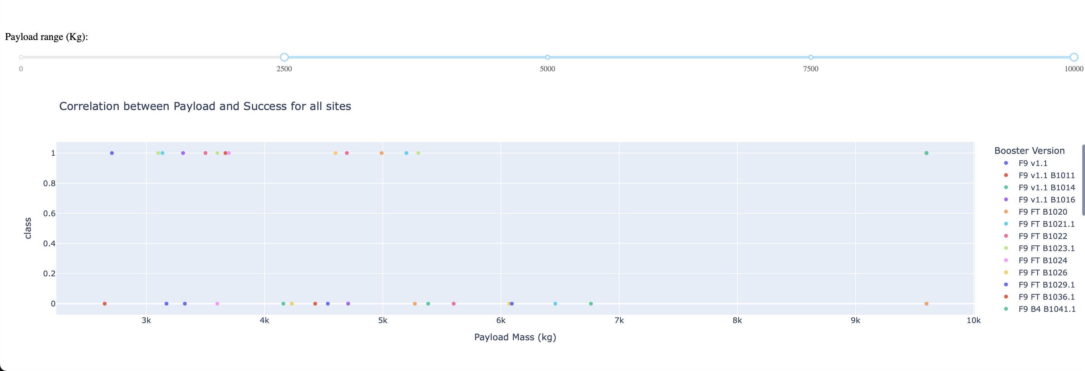
Relation between Payload and Success Rate for all Sites
The graph shows that as the payload mass gets heavier, there is lesser chance of success.

Slide 42

Section 5

Slide 43
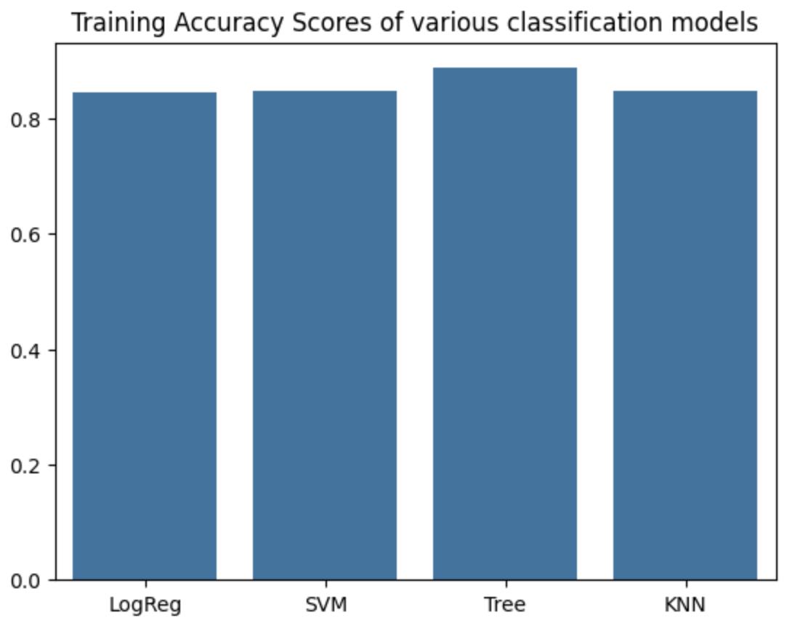
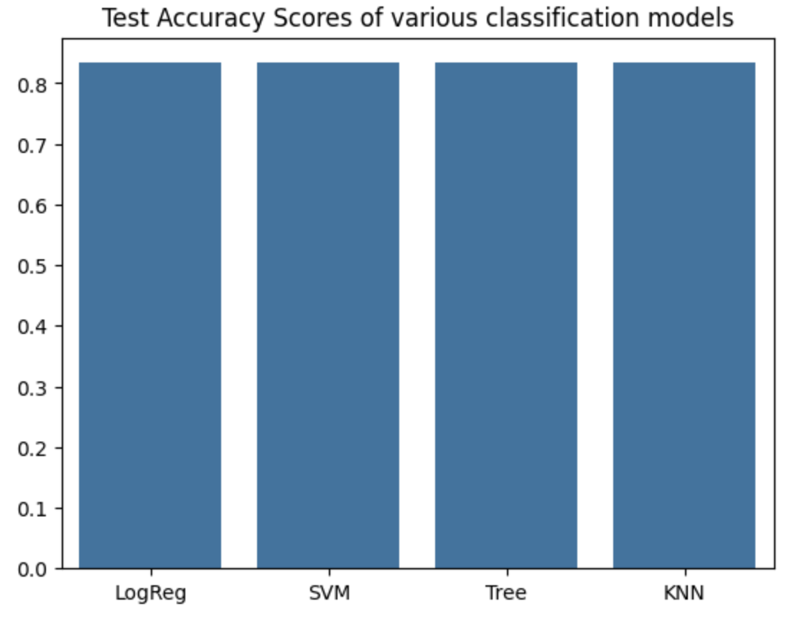
Classification Accuracy
Based on the bar graph shown on the right, all classification models are getting same training accuracy except Decision Tree Classifier with an accuracy of around 88%.
Based on the test accuracies, it is evident that except Decision Tree Classifier any other model can be picked up as decision tree is overfitting as there is quite a noticeable difference between train and test accuracies.
For simplicity we can pick Logistic Regression model as the passed data has been transformed into numeric data with standardization.

Slide 44
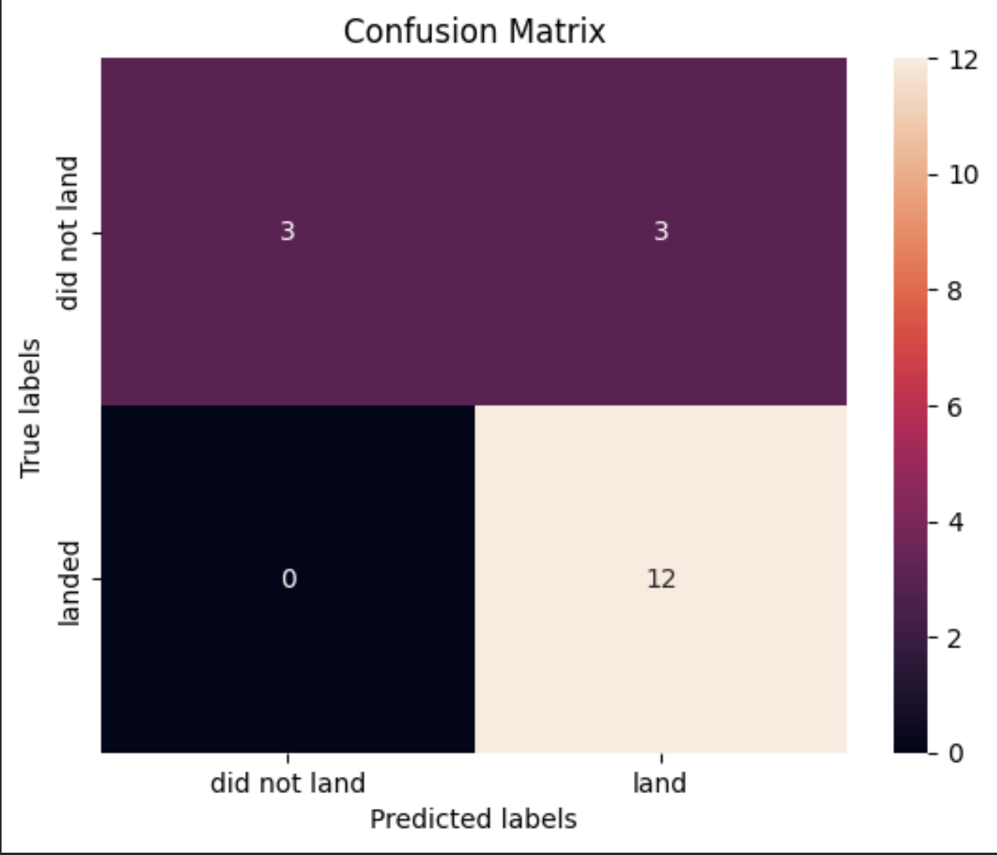
Confusion Matrix
This metric is for logistic regression model.
The matrix on the right is the confusion matrix with:
False Negatives = 0
False Positives = 3
This shows that the model is performing quite well on the training data.
The training accuracy is around 85% with test accuracy of 83%.

Slide 45
Conclusions
By doing this analysis we can conclude that based on features like Flight Number, Orbit, Payload Mass, Launch Sites and other such variables we can determine whether the first stage will be successful or not. This is crucial in determining the cost of the project.
Since the classification models are generalizing quite well on the prior data. It means that they can predict the outcome of the mission with high precision and good recall.
Though in past the chances of success were low, as the time progressed there was a steady growth in success rates as the techniques were improved based on previous failures.
The KSC LC-39A launch site has the highest success rate among other sites which give a good advantage to SpaceX in terms of cost management as they can reuse their first stage rockets.

Slide 46
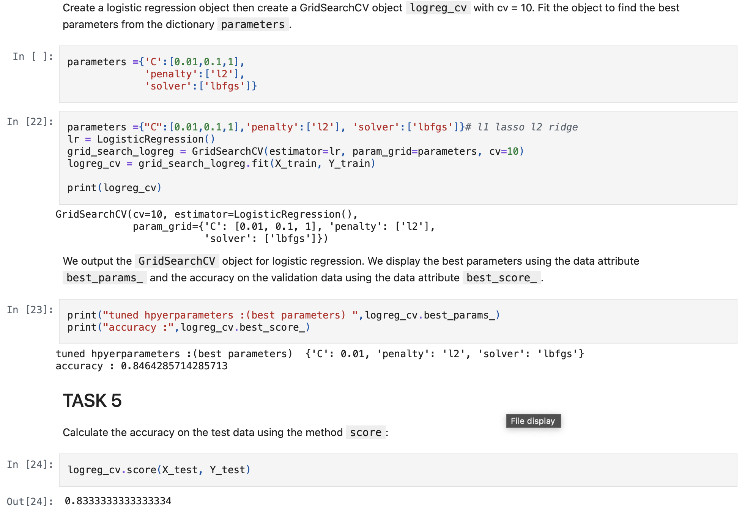
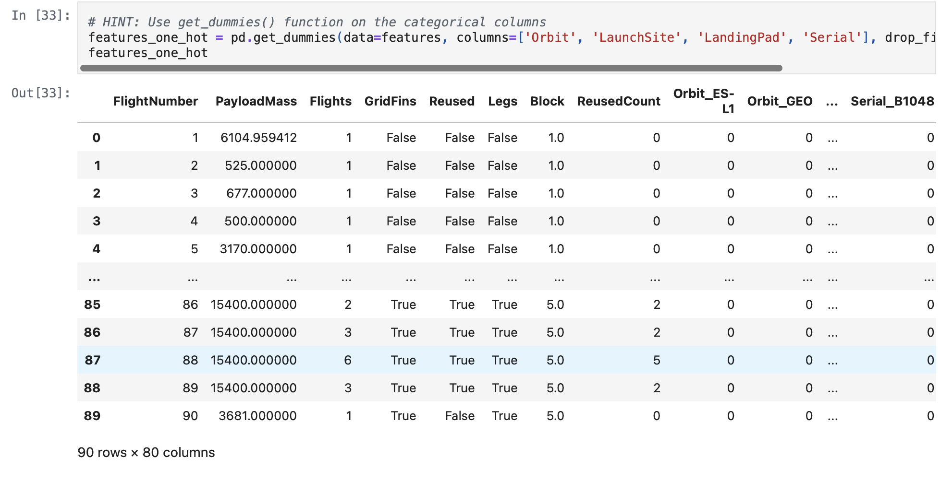
Appendix
Best model training and metrics
Transformed data for model

Slide 47


